Slide 1

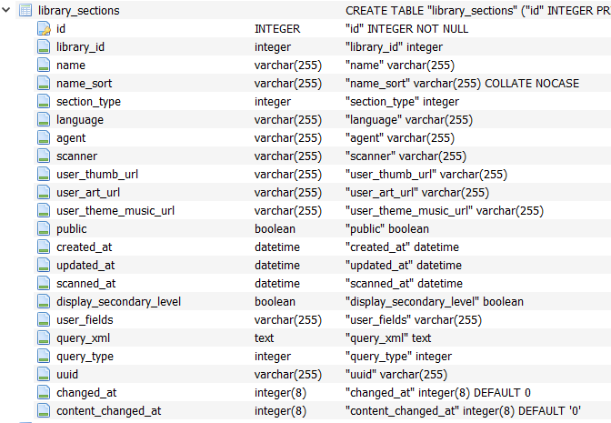
Library_sections
1 = movies
3 = music
13 = photos

Slide 2



Type 13 = photo
Find images
We add two fields in media_items table:
TTP_updated_at
Place_upated_at

Slide 3



Find images2
mid
Thumb

Slide 4


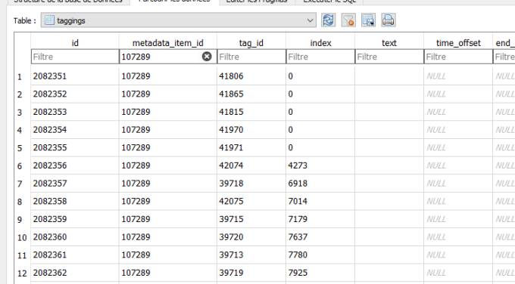


FACE
media_parts
media_items
taggings
Must be 0 for user tag
Must be 0 for user tag
And extra_data=FACE
tags

Slide 5


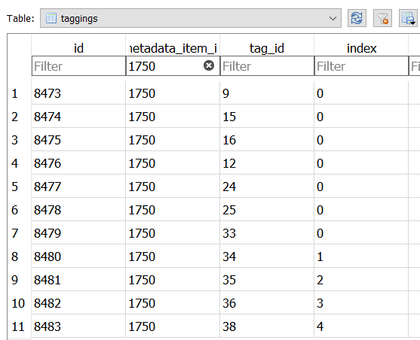

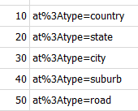
Place Tags
media_parts
media_items
taggings
Must be 400 for Place tag
tags
Index:
0 for country
1 for district/urban area
2 for county/Region
3 for city
4 for Street/Poi
Tag_value:
50 for road/POI
40 for district/suburb
30 for city
20 for county/state
10 for country

Slide 6


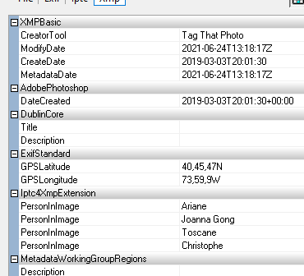



L0CATABLE
= 40.76305556, -73.98583333

Slide 7



FACE Tags
0 for user tag

Slide 8
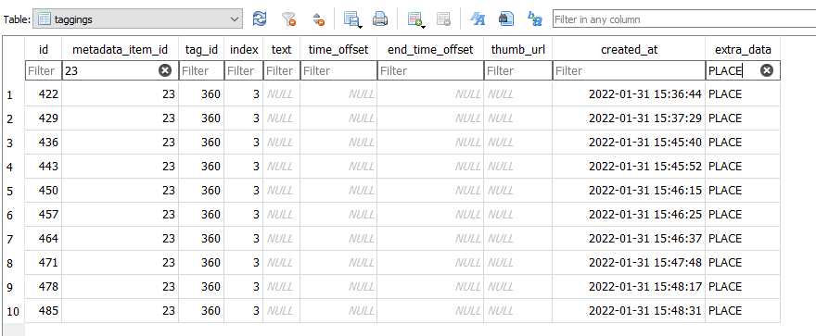

PLACE Tags
Index:
0 for country
1 for district/urban area
2 for county/Region
3 for city
4 for Street/Poi
Tag_value:
50 for Street/POI
40 for district
30 for city
20 for county
10 for country
400 for PLACE tag

